Slide 1
Exam 4 Ch 30 & 31
Circuits with Inductors, Resistors, & Capacitors
Alternating Current

Slide 2

Ch 30-1 Inductors
Mutual Inductance:
$ε_{2}=−\frac{d{Φ_{B}}_{2}}{dt}N_{2}=−M\frac{di}{dt}$,
$N_{2}Φ_{B_{2}}=Mi_{1}$,
$M=\frac{N_{2}Φ_{B_{2}}}{i_{1}}$
Self-inductance:
$L=\frac{NΦ_{B}}{i}$
$ε=−L\frac{di}{dt}$
Energy Stored in Inductor:
$U=\frac{1}{2}LI^{2}$

Slide 3
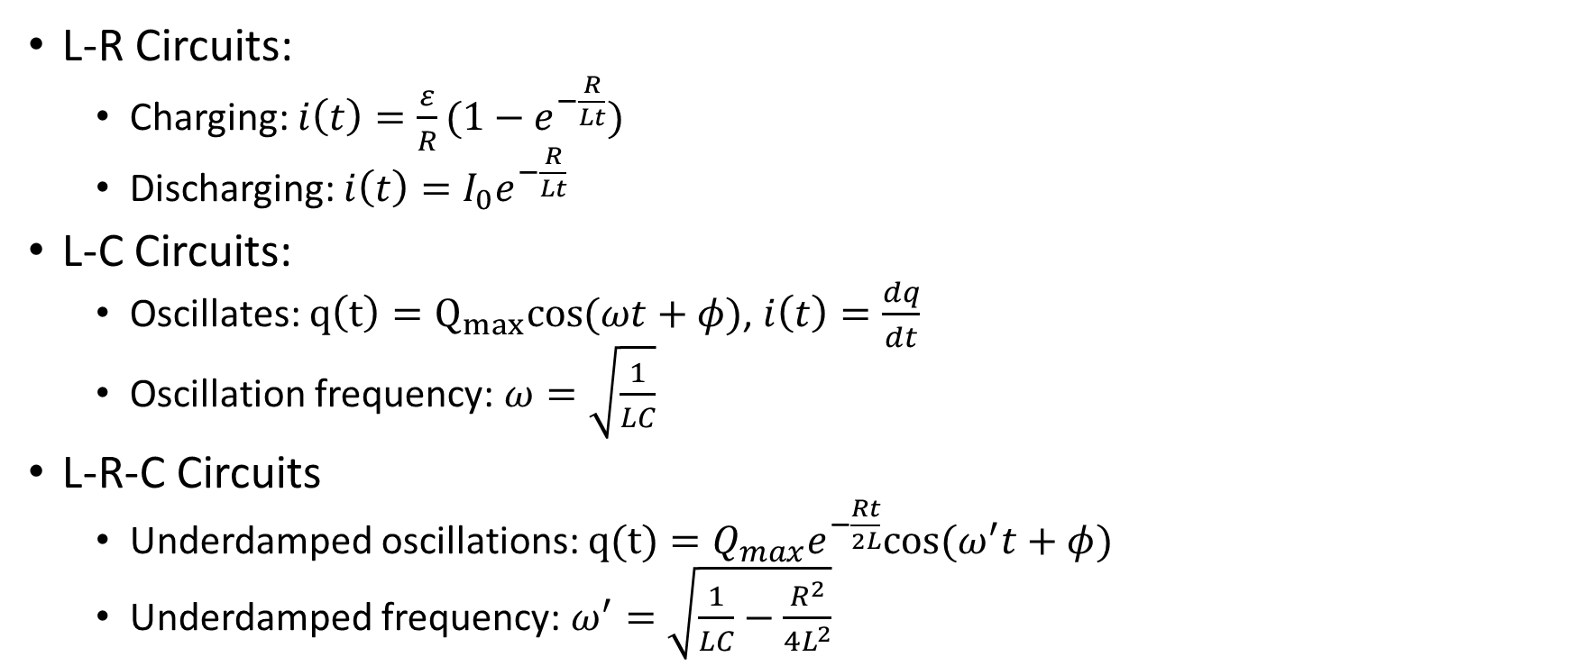
Ch 30-2 Inductors in Circuits
L-R Circuits:
Charging: $i\left(t\right)=\frac{ε}{R}(1−e^{−\frac{R}{Lt}})$
Discharging: $i\left(t\right)=I_{0}e^{−\frac{R}{Lt}}$
L-C Circuits:
Oscillates: $q\left(t\right)=Q_{max}cos{(ωt+φ)}$, $i\left(t\right)=\frac{dq}{dt}$
Oscillation frequency: $ω=\sqrt{\frac{1}{LC}}$
L-R-C Circuits
Underdamped oscillations: $q(t)=Q_{max}e^{−\frac{Rt}{2L}}cos⁡(ω^{′}t+φ)$
Underdamped frequency: $ω^{′}=\sqrt{\frac{1}{LC}−\frac{R^{2}}{4L^{2}}}$

Slide 4

Ch 31 AC Circuits
$V_{R}=IR, V_{c}={Ix}_{c}, V_{L}={Ix}_{L}$
ELI, ICE
$v\left(t\right)=V_{max}\sin{(ωt+φ)}$
$f=\frac{ω}{2π}$
$x_{c}=\frac{1}{ωC}$, $x_{L}=ωL$
$z=\sqrt{R^{2}+{\left(x_{L}−x_{C}\right)}^{2}},\tan{φ}=\frac{x_{L}−x_{C}}{R}$
$P_{av}=\frac{1}{2}VIcosφ$
Transformer & rms

